Slide 1
Libraries and Drivers
Chun Hui, Clarence and Adeline
SUTD ORGANIZATION OF AUTONOMOUS ROBOTICS

Slide 2
Timeline - Software
Introduction to microcontrollers
Introduction to Arduino IDE
Programming logic
PWM
Libraries
Motor driver
Week 2
Week 3
Week 4

Slide 3
Recommendations
Bring your own computer.
Arduino IDE must be installed from this link:
https://www.arduino.cc/en/software
DO NOT DOWNLOAD FROM WINDOWS STORE.
Download the CH340 Driver from this link:
https://sparks.gogo.co.nz/ch340.html

Slide 4
Libraries and Drivers
Chun Hui, Clarence, Sin Kiat
SUTD ORGANIZATION OF AUTONOMOUS ROBOTICS

Slide 5
Agenda
Get data from ultrasound sensors
Import a library to control servos
Make a motor driver from scratch
Hopefully, you can do all these by the end of today.

Slide 6
Progress
Get data from ultrasound sensors
Import a library to control servos
Make a motor driver from scratch

Slide 7
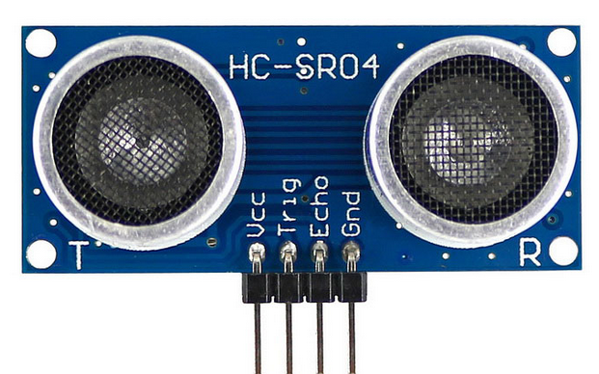





HC-SR04
Notes:
Operating range -3cm

Slide 8
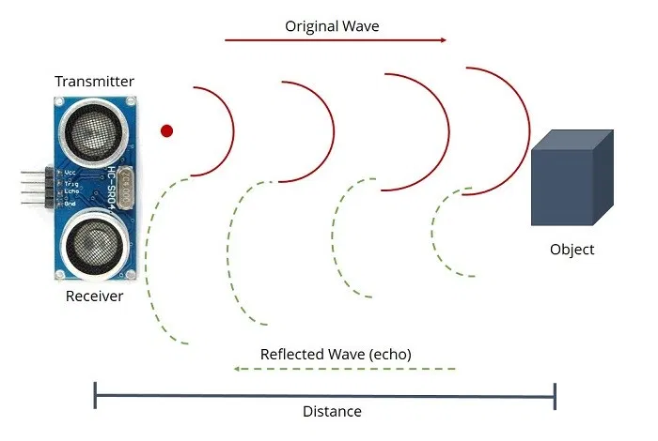
Ultrasonic Sensor
Notes:
How do ultrasonic sensors work? Sound travels at a fixed speed of 330m in air, therefore by detecting the period of time it takes for the same sound wave to return (presumably without noise at that frequency) you can use some math to calculate the distance travelled. Some of the ultrasonic sensors can also use intensity or phase change of the wave, but mostly they just use time.

Slide 9
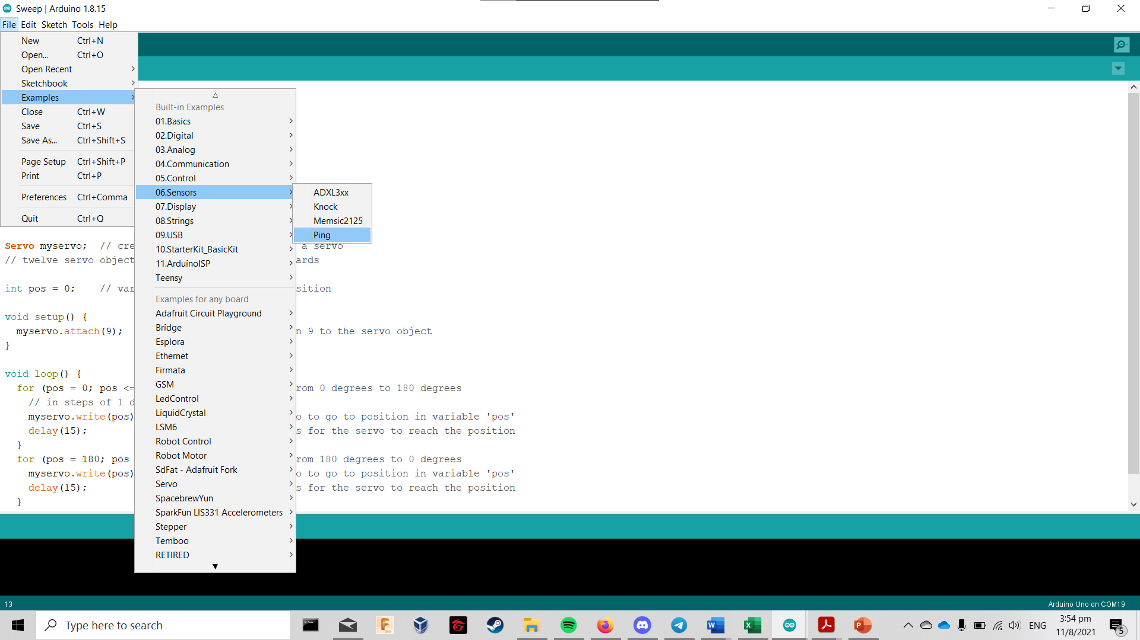
Arduino Example Code

Slide 10
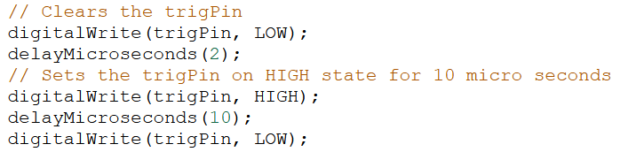
Consider this!
In the “ping” example, how can we read legible data from the sensor?
Find the mathematical formula used to find the distance in cm.
What does this block of code do? Why is it important?
Notes:
Answers:
1. Open serial monitor at 9600 baud rate, the data is being sent to the serial monitor.
2. it’s DST, then divide by 2 because the wave is reflected which means it travels twice the distance.
3. It causes the pinger to turn on for 2 microseconds, then off for 5 microseconds.

Slide 11
Answers
In the “ping” example, how can we read legible data from the sensor?
A: Through the serial monitor.
Find the mathematical formula used to find the distance in cm.
A: Check distance line
What does this block of code do? Why is it important?
A: It sends out the sound pulse from the emitter (trigPin).
Notes:
Answers:
1. Open serial monitor at 9600 baud rate, the data is being sent to the serial monitor.
2. it’s DST, then divide by 2 because the wave is reflected which means it travels twice the distance.
3. It causes the pinger to turn on for 2 microseconds, then off for 5 microseconds.

Slide 12
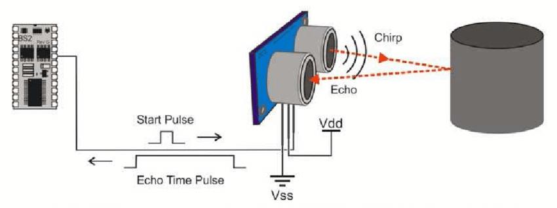
Ultrasonic Sensor
Notes:
You can see the waveform of the pulse here.
Reason why ultrasonic is so widely used is because its relatively easy to acquire, and works on most surfaces. Thus, it’s good to know how it operates well.

Slide 13
Task 1 – till 7.23pm
Read data successfully from the ultrasonic sensor via serial monitor.
Hint:
Go online to find the pinout diagram.
Just delegate something to control the ping pin and something to receive data from the echo pin.

Slide 14
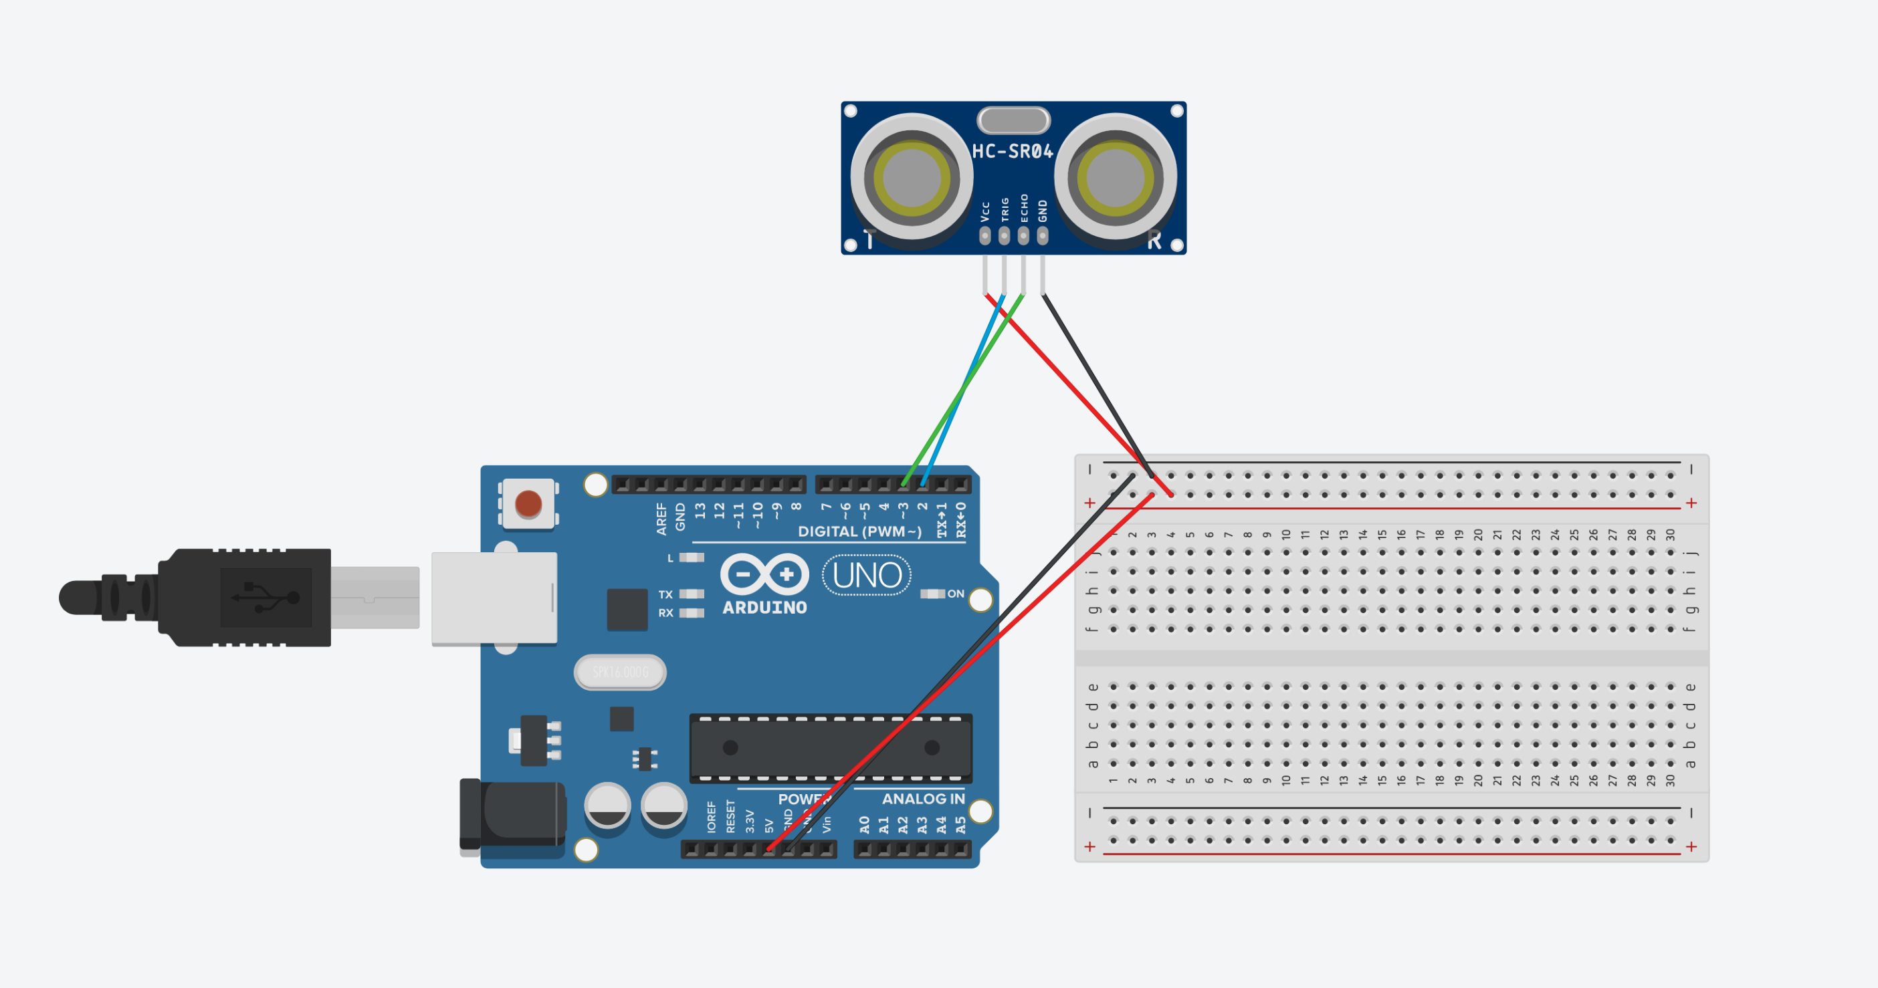

Slide 15
Get data from ultrasound sensors
Import a library to control servos
Make a motor driver from scratch
Progress

Slide 16
Library
Comes with pre-made additional functions
Check documentation for usage
Needs to be included in the code before usage
#include <library_name.h>
The library needs to be downloaded first
Some libraries may not work for Windows Store Arduino IDE
Download methods:
Library manager
Github download > move into Libraries folder

Slide 17
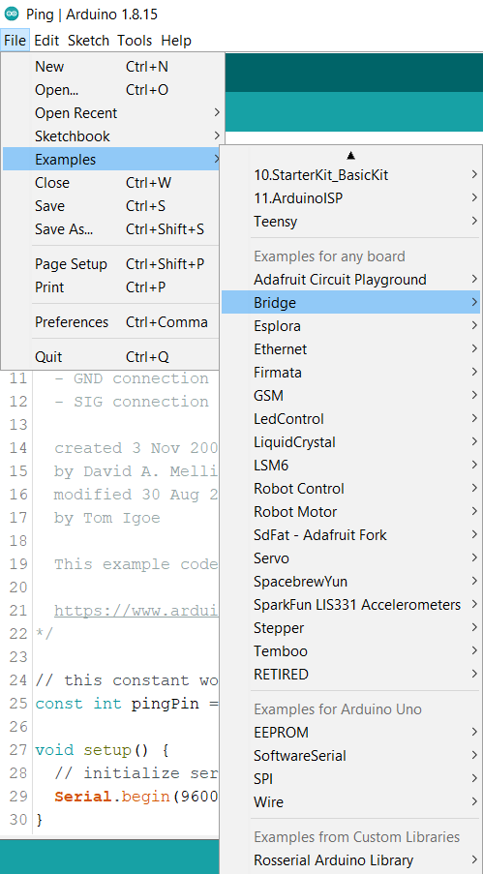
Installed libraries
Faster way to check

Slide 18
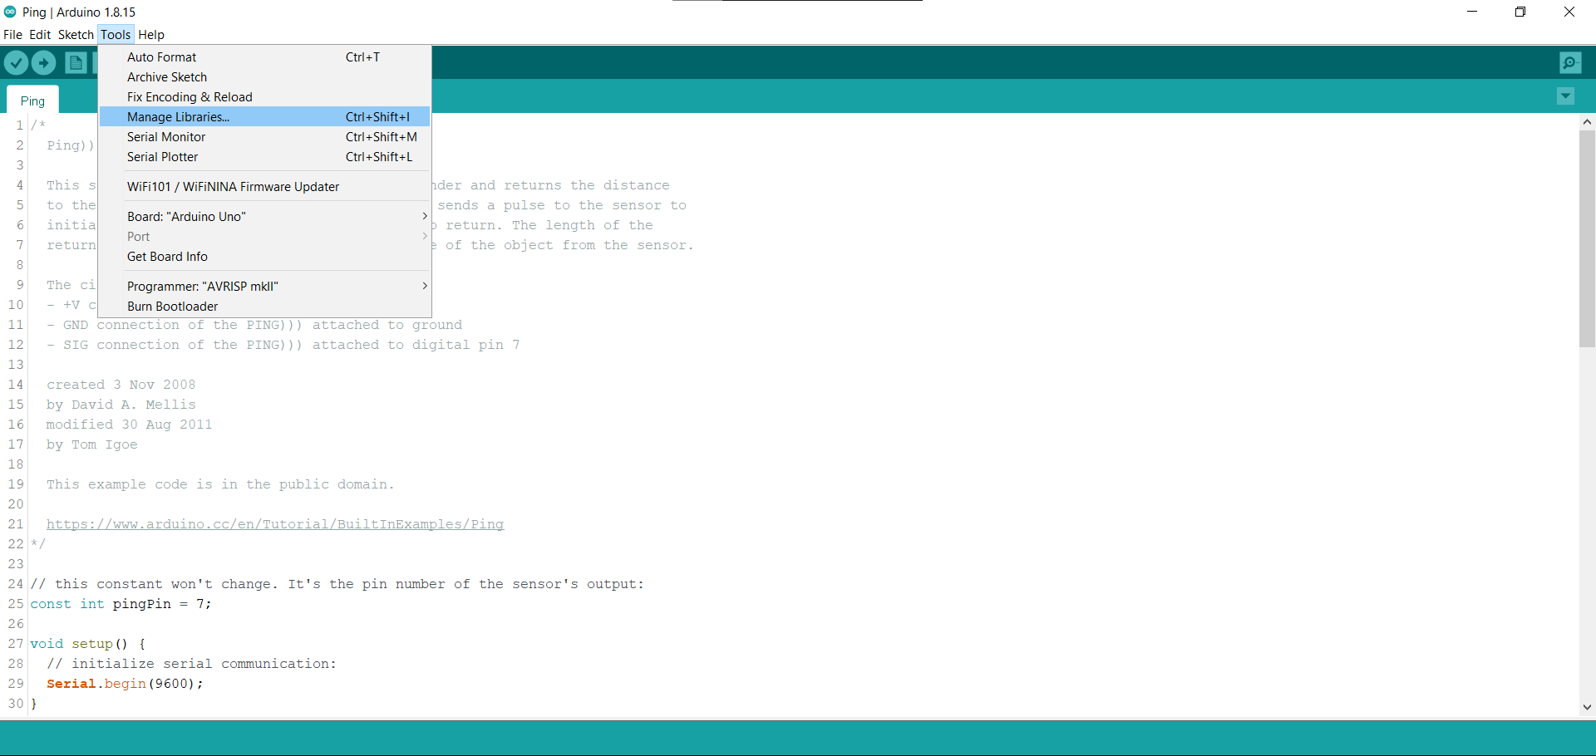

Slide 19
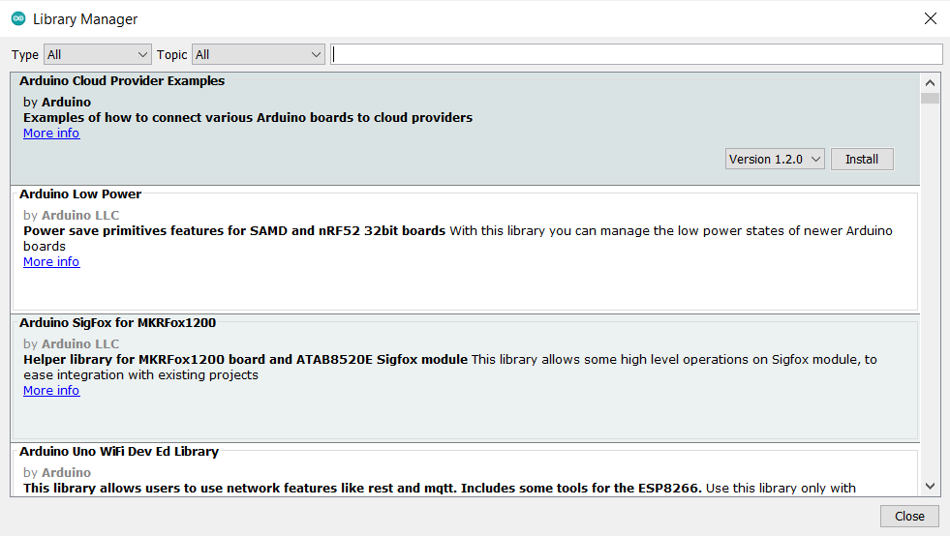
Library Manager

Slide 20
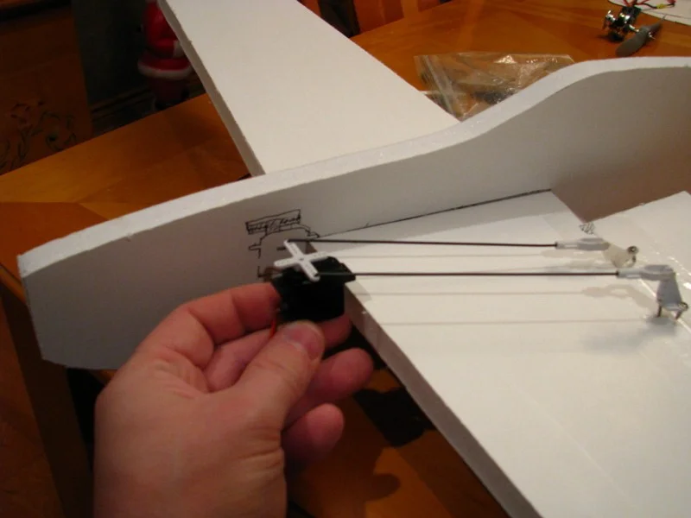
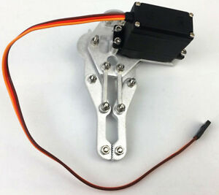
Servo
Notes:
Servos are a type of actuators. Actuators convert electrical signals into mechanical motions, which is exactly the case with these servos. They convert electrical signals into rotational motion as seen here, and you can expand on this motion with these control horns that can be made of plastic or metal. For instance, if you build a foam plane, you can use some metal rods through these control horns to move your plane’s ailerons (the wing flaps).
Two types of servos: continuous and positional (find the phrsing)

Slide 21
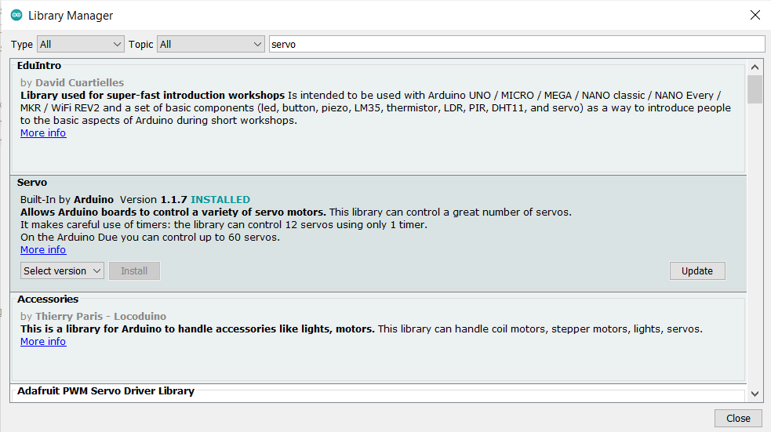
Servo.h

Slide 22
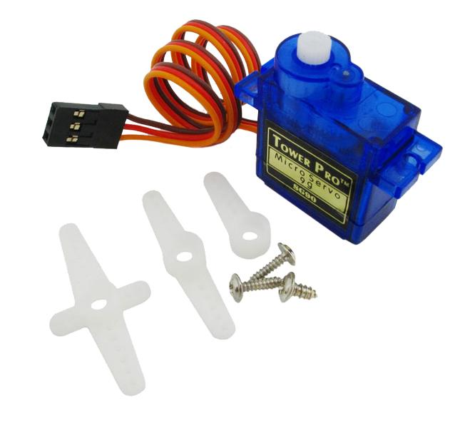
Servo
Control Horns
Notes:
Servos are a type of actuators. Actuators convert electrical signals into mechanical motions, which is exactly the case with these servos. They convert electrical signals into rotational motion as seen here, and you can expand on this motion with these control horns that can be made of plastic or metal. For instance, if you build a foam plane, you can use some metal rods through these control horns to move your plane’s ailerons (the wing flaps).
Two types of servos: continuous and positional (find the phrsing)

Slide 23
Task 2 – 7.45pm
Get the servo to do a sweeping motion.
Hints:
Go online to find the pinout diagram.

Slide 24
Get data from ultrasound sensors
Import a library to control servos
Make a motor driver from scratch
Progress

Slide 25
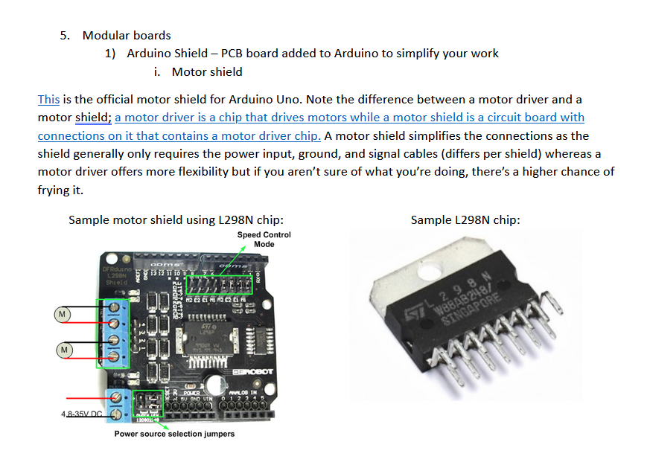
Document Page 54

Slide 26
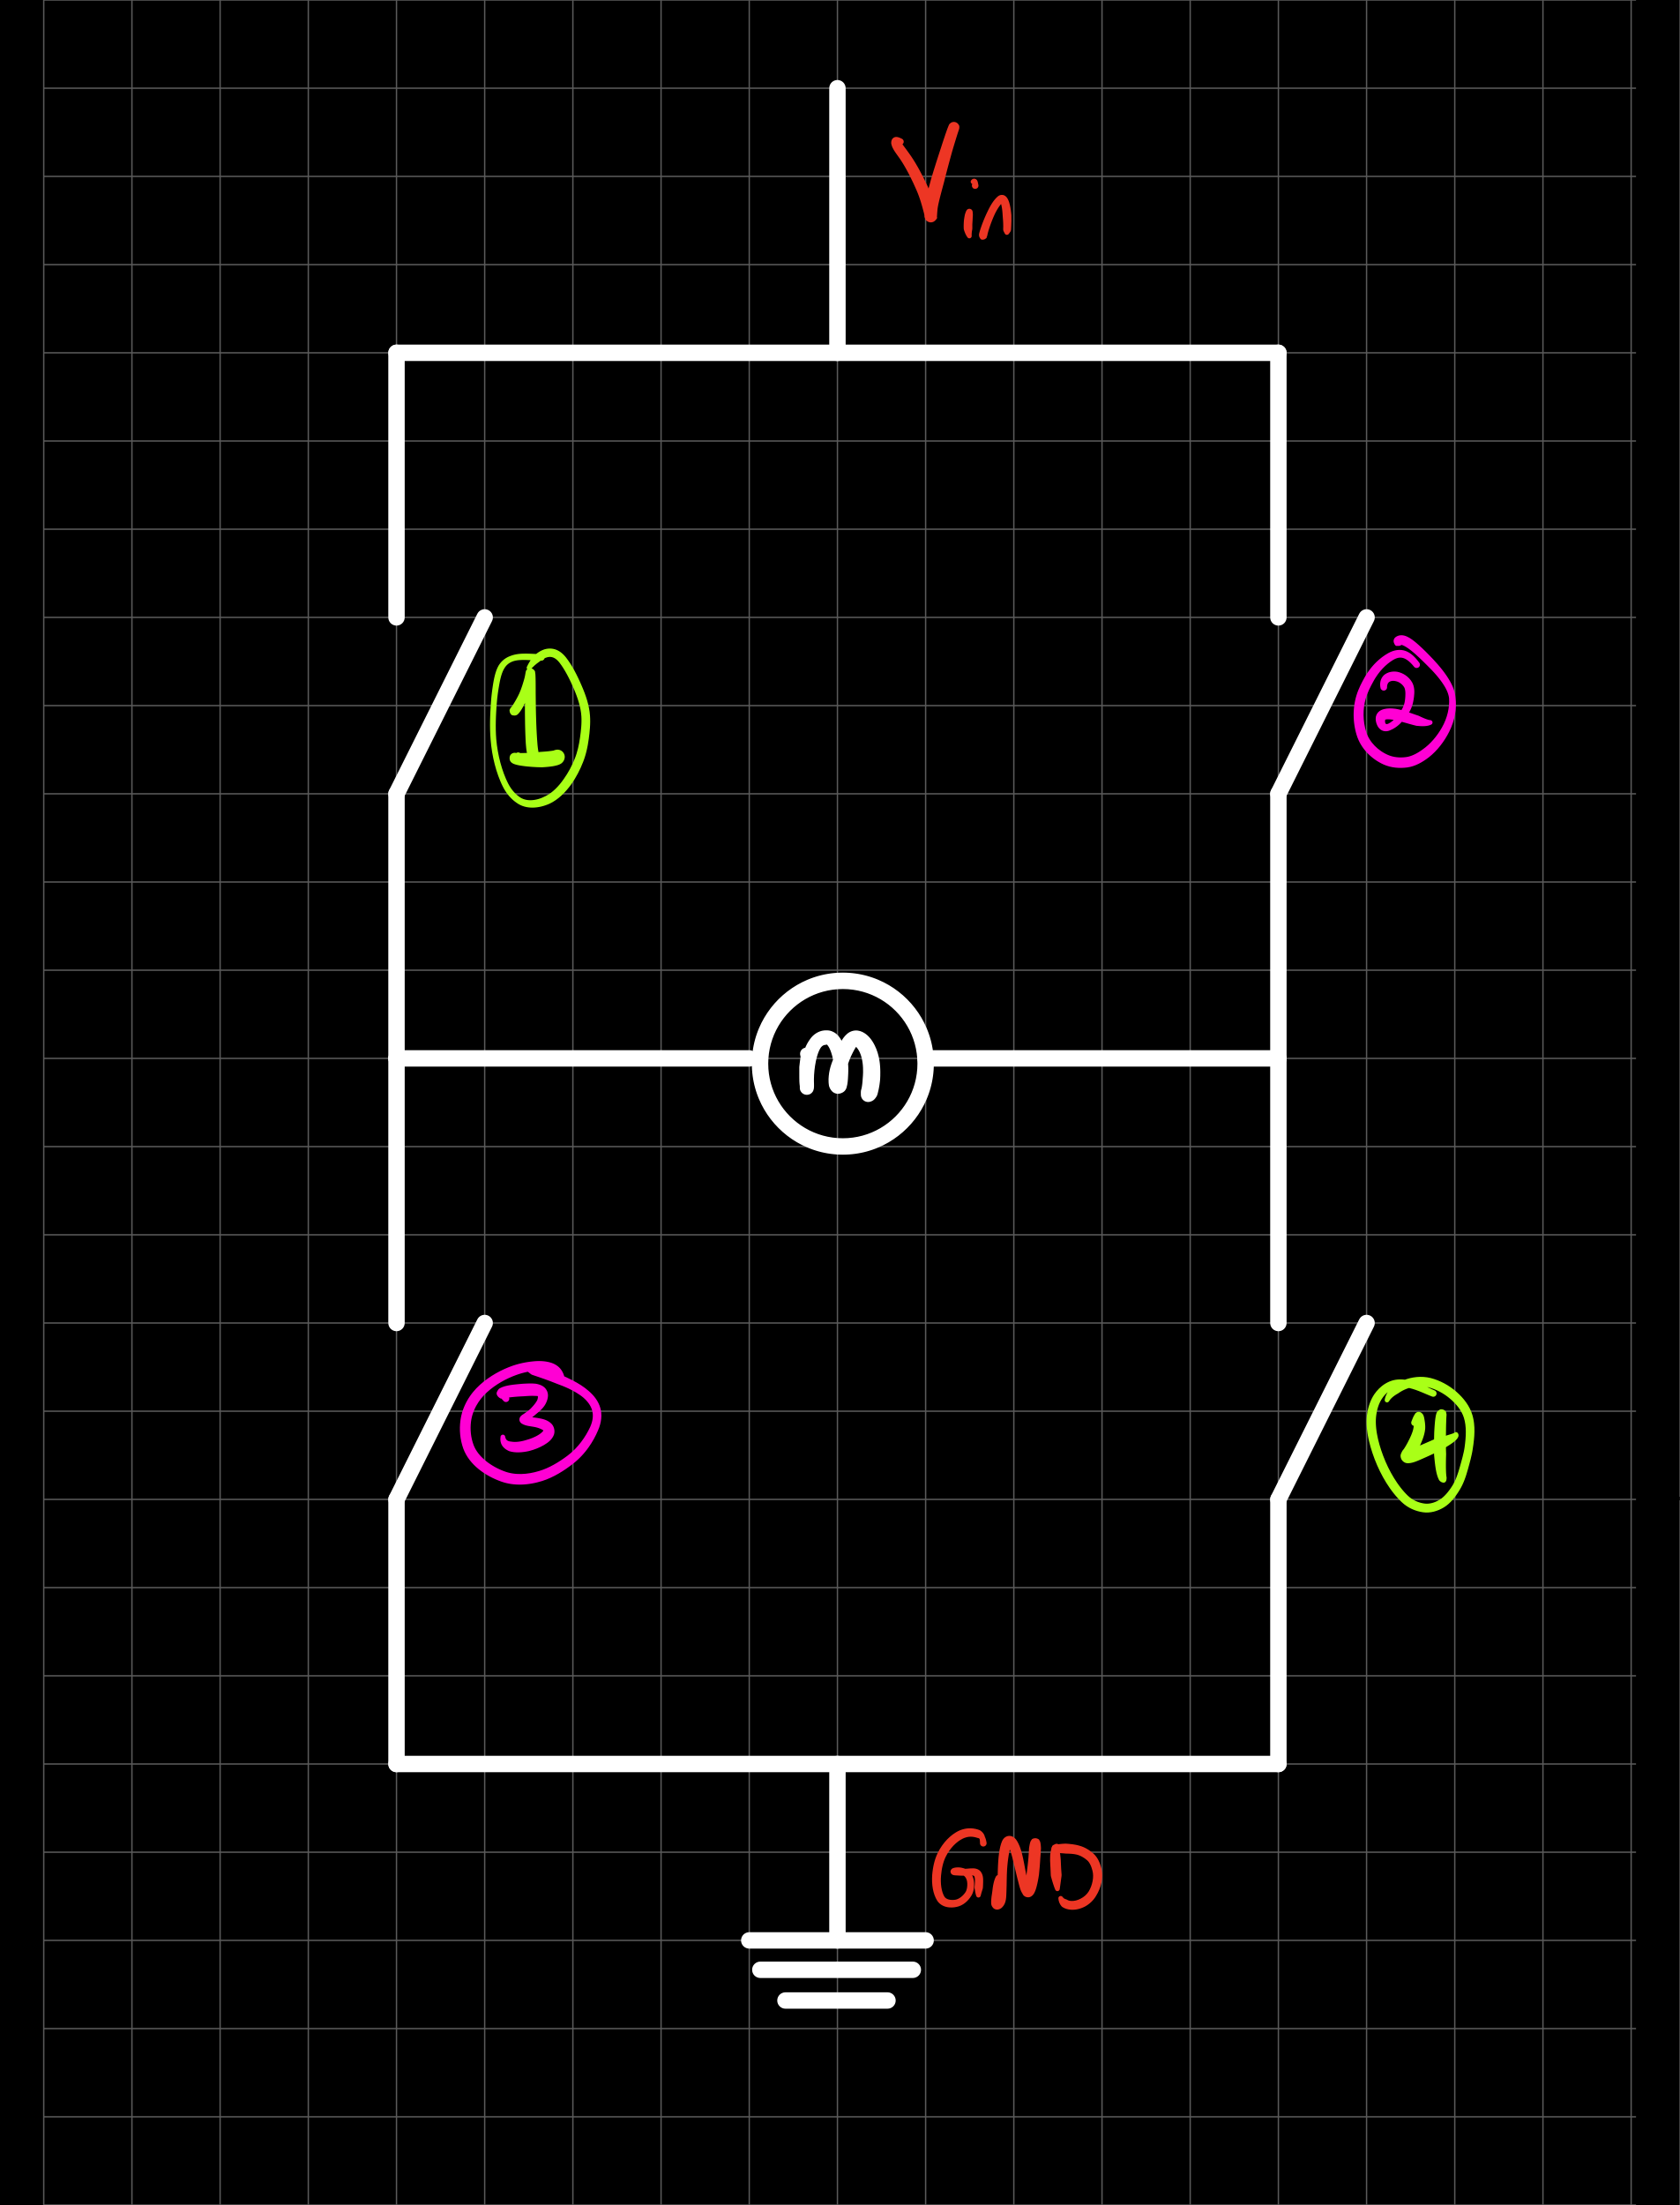
How does H-bridge work?
Switch | 1 | 2 | 3 | 4 | Result
Test 1 | 1 |  |  | 1
Test 2 |  | 1 | 1
Test 3 | 1 | 1
Test 4 | 1 | 1 | 1

Slide 27
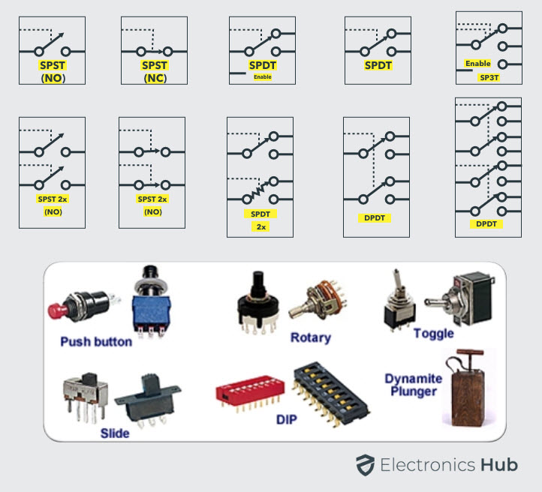
Switches

Slide 28
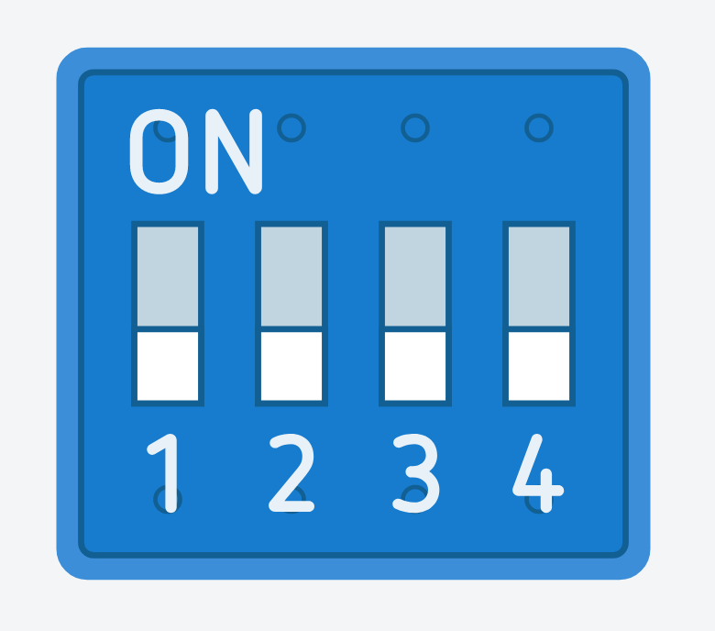





Tinkercad

Slide 29
How does H-bridge work?
Switch | 1 | 2 | 3 | 4 | Result
Test 1 | 1 |  |  | 1 | ->
Test 2 |  | 1 | 1 |  | <-
Test 3 | 1 | 1 |  |  | Doesn't turn
Test 4 | 1 | 1 | 1 |  | -> slower

Slide 30
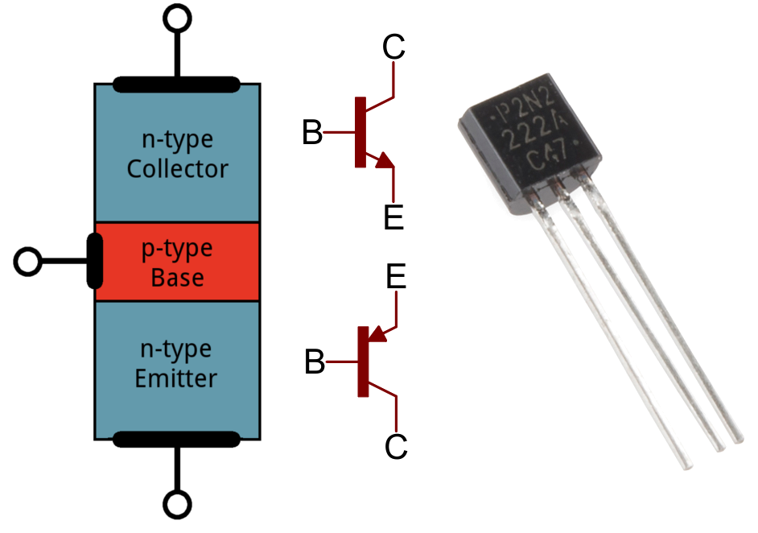
Mosfet, transistors, pg 52

Slide 31
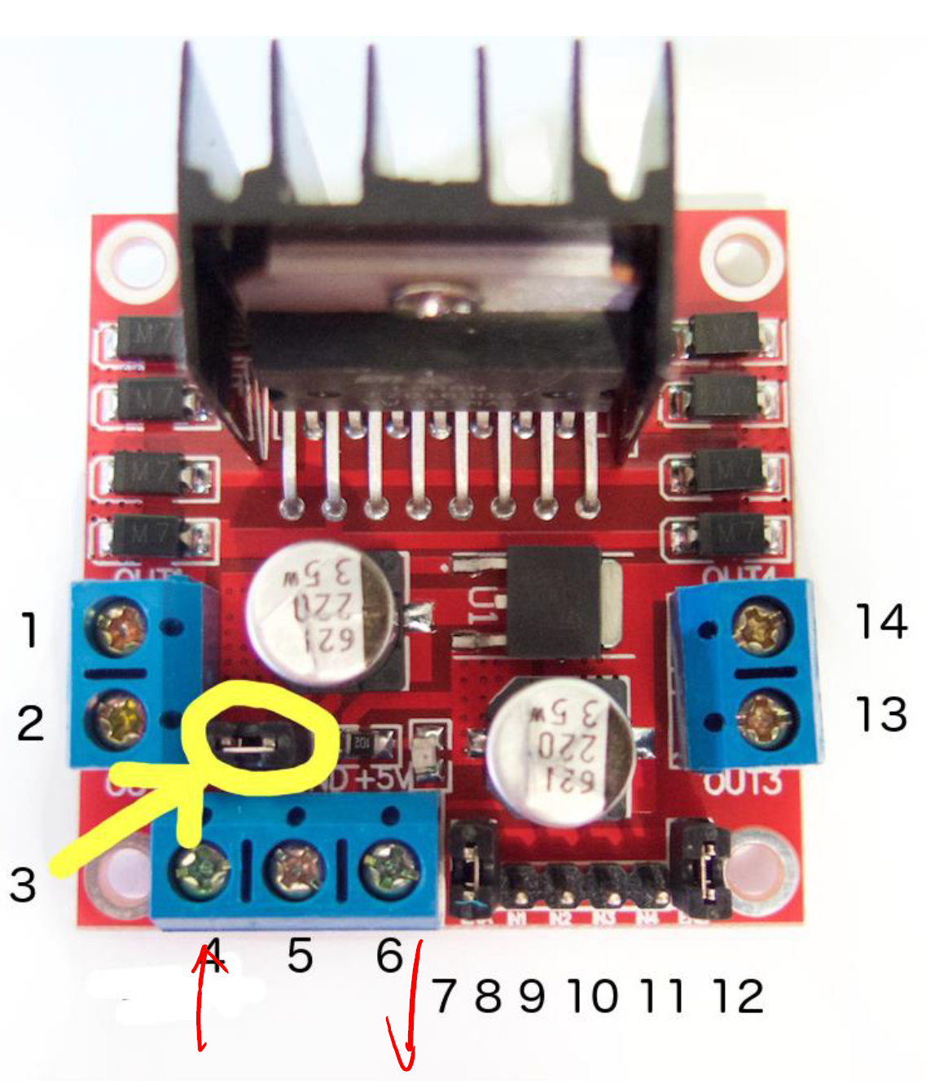
DC motor 1 "+"
DC motor 1 "
12V jumper
Only remove this if using a supply voltage greater than 12V DC.
This enables power to the onboard 5V regulator
Motor supply voltage
Maximum of 35V DC
Remove 12V jumper if > 12V DC
GND
5V output if 12V jumper in place
Can be input as well

Slide 32
DC motor 1 enable jumper
Usually connected to PWM output for speed control
Do not remove the jumper (yet)
IN1 (digital input pin) (controls motor 1)
IN2 (digital input pin) (controls motor 1)
IN3 (digital input pin) (controls motor 2)
IN4 (digital input pin) (controls motor 2)
DC motor 2 enable jumper
DC motor 2 "+"
DC motor 2 " "--"

Slide 33
Task 3 (Optional)
Get the motor to spin in alternating directions in intervals of 5s.

